Slide 1
Book Interface
Sabrina Kabir

Slide 2
Introduction
Background information on the project
Overall purpose
What was the main goal?
Expected outcomes for this project

Slide 3
Programming Information
Main coding languages
What were some limitations for this project?

Slide 4
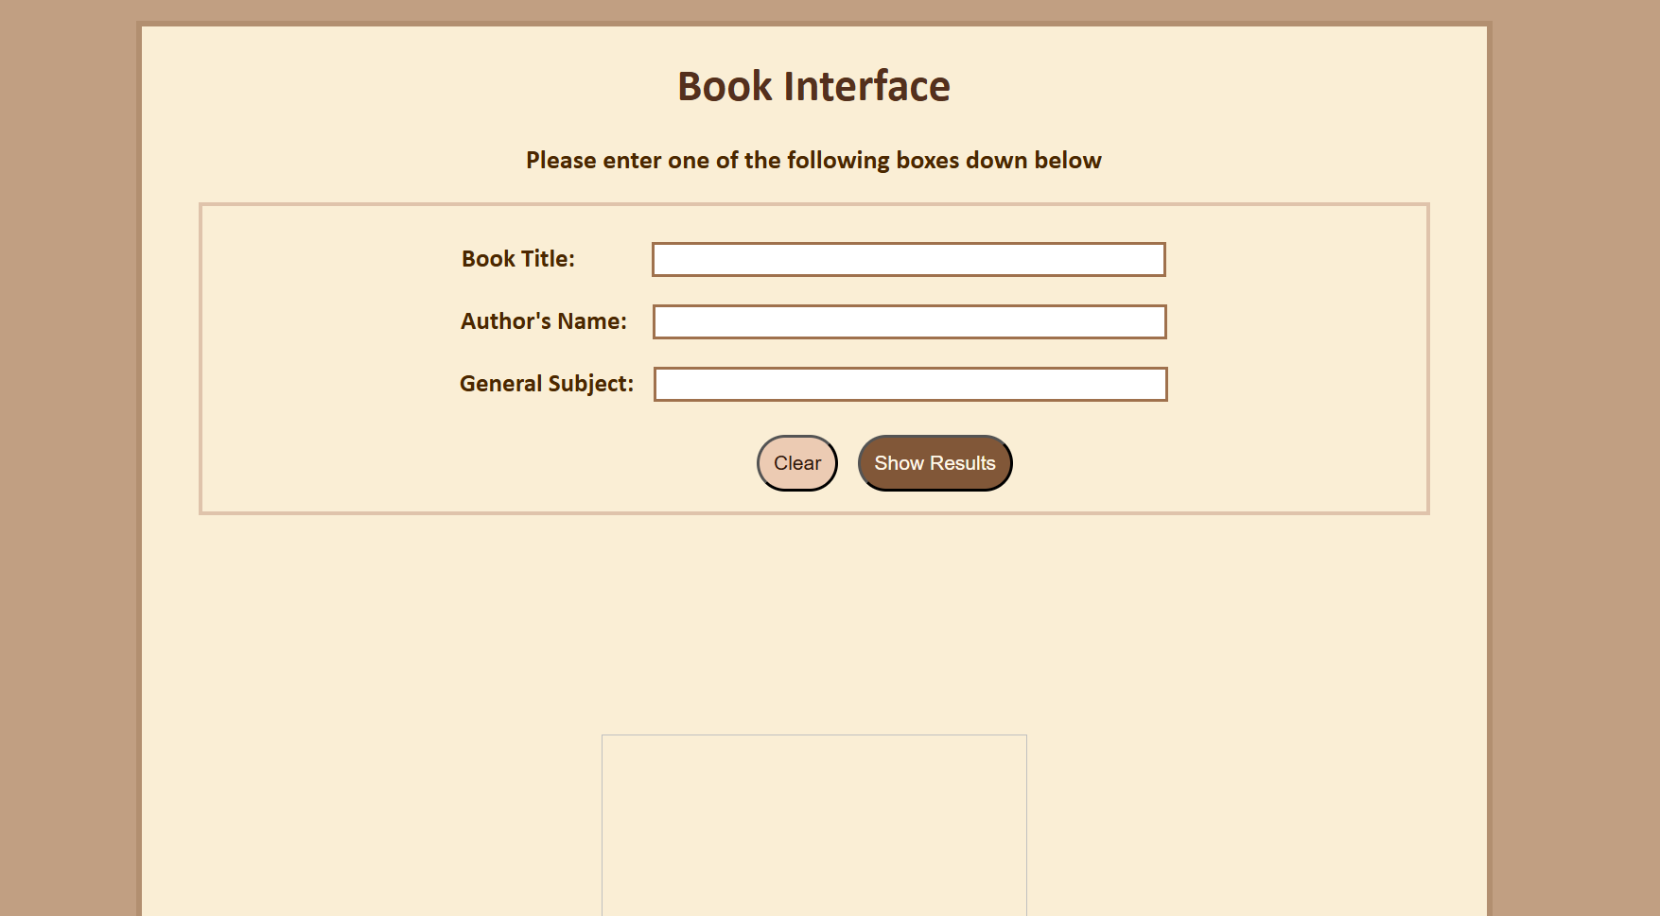

Interface Design

Slide 5
Project
Book interface project link:
https://sabrina200424.github.io/portfolio/Book-Interface-Project/index.html

